Slide 1
Zomato Restaurant Data Analysis
Analyzing Restaurant Characteristics and Customer Engagement

Slide 2
OBJECTIVE
To analyze the key factors influencing restaurant popularity and operational choices on the Zomato platform
Data Source: Zomato data .csv
Zomato data consists of 148 rows and 7 columns.
Key Variables: Briefly list the columns you focused on: Rate, Votes, Online_order, Book_table, and Listed_in(type).

Slide 3
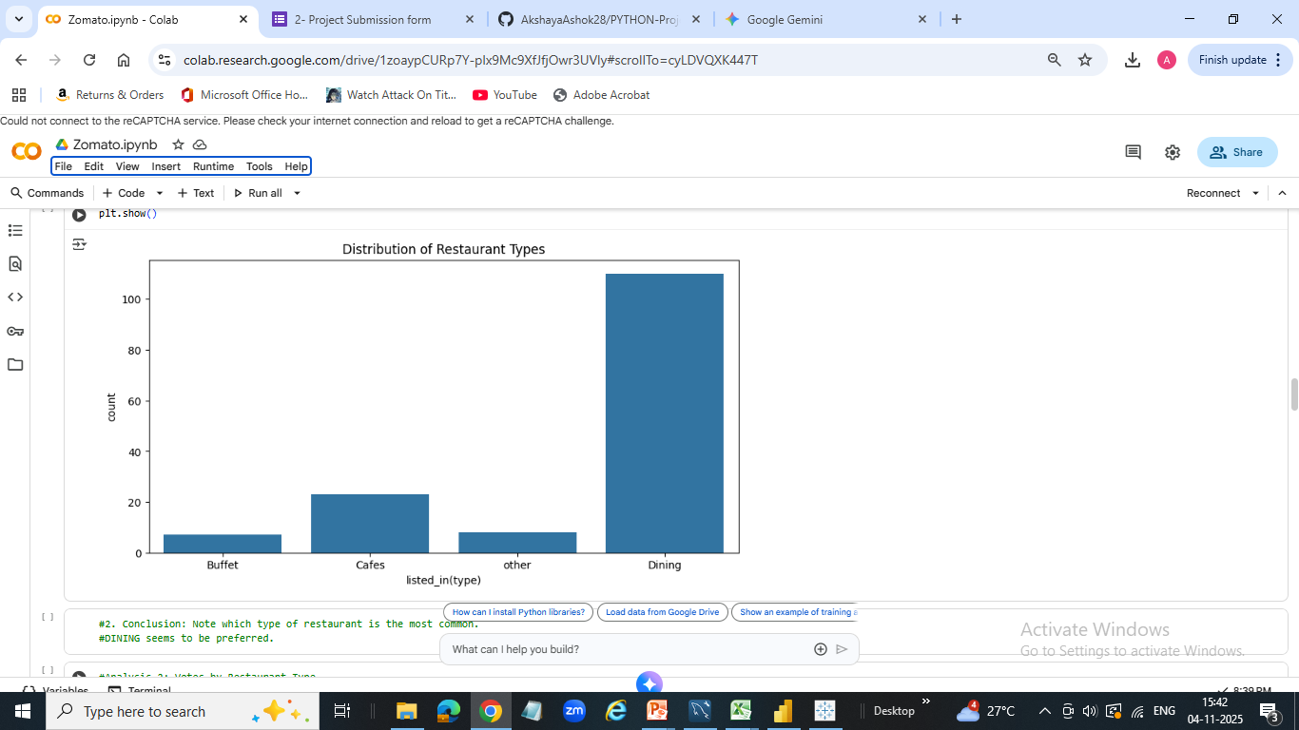
CORE FINDINGS
Finding 1: Distribution of Restaurant Types.
Visualization: Used the Count Plot for 'listed_in(type)' (Analysis 1).
Insight: State which type of restaurant is most prevalent (e.g., Dining/Cafes), found that "The Zomato platform is heavily dominated by Dining establishments, followed by Cafes.“

Slide 4
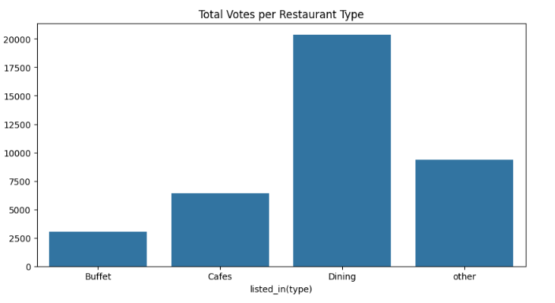
Finding 2: Popularity and Service Channels.
Visualization: Used the Bar Plot for 'Total Votes per Restaurant Type' (Analysis 2).
Insight: State which restaurant type receives the most total votes (highest public engagement). Found that "[Highest Voted Type, e.g., Dining] receives the overwhelming majority of customer votes, indicating where public opinion and high traffic are concentrated."

Slide 5
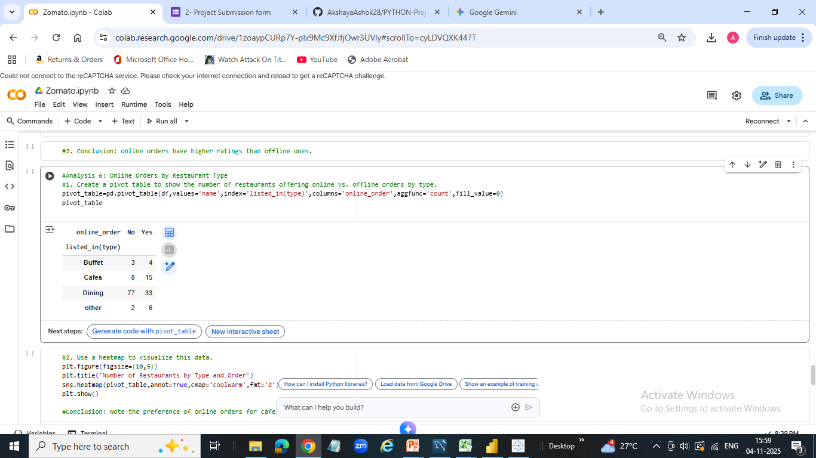
Finding 3: Adoption of Online Services
Visualization: Used Pivot Table Plot for 'book_table vs. online_order' (Analysis 4).
Insight: Discussed the proportion of restaurants that offer online ordering. Highlighted the relationship between online order and table booking.

Slide 6
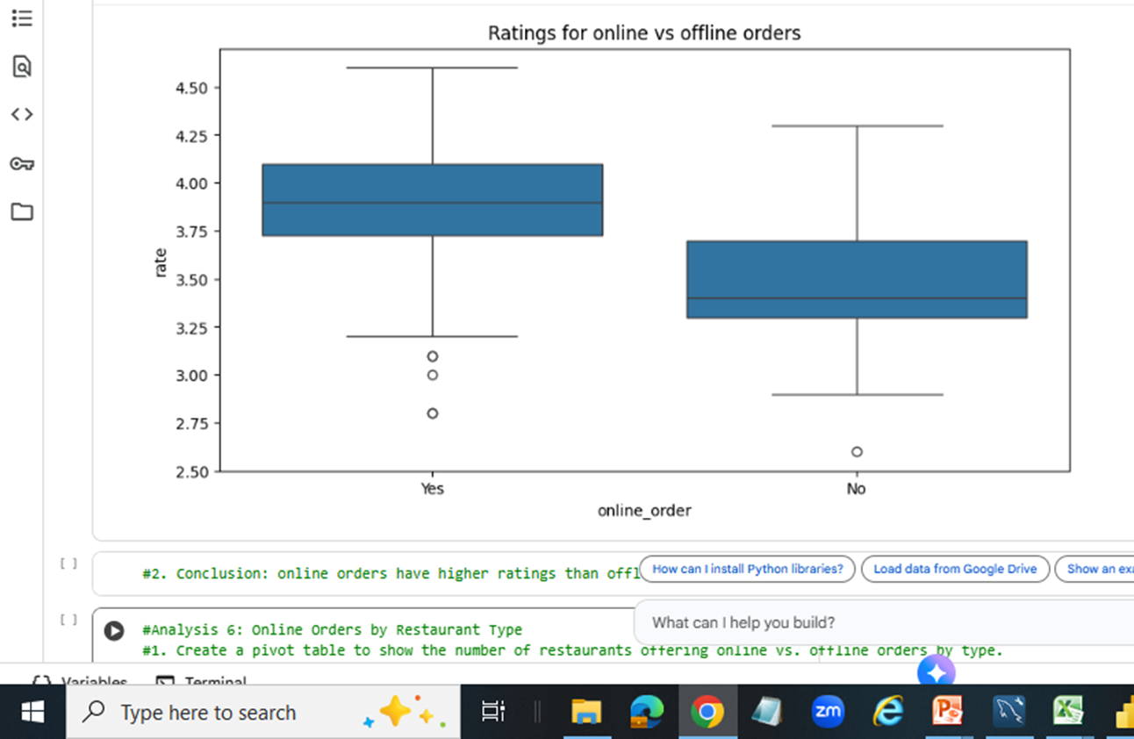
Finding 4: The Impact of Service Channel on Rating
Visualization: Use the Box Plot for 'Ratings for online vs offline orders' (Analysis 5).
Insight: By Comparing the average rating (mean/median) between restaurants that accept online orders and those that don't. Example: "Restaurants offering online orders have a slightly higher (or lower) average rating than those of offline orders.

Slide 7
CONCLUSION AND RECOMMENDATIONS
Conclusion:
Dining type is the core business, but service quality depends on online order availability.
Recommendation 1 (Operational):
Based on the online/offline rating, we recommend if Zomato should push more for quality control in one area.
Recommendation 2 (Market):
Based on the most prevalent type (Dining) and most voted type, advise on which restaurant segment Zomato should focus its marketing efforts.

Slide 8
GITHUB LINK

